Slide 1

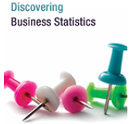
DSCI 2710 ‒ Lecture 7 UNTDBS Lessons 6.1-6.3
Discrete Random Variables
Slide Material from: Nottingham & Hawkes, Discovering Business Statistics

Slide 2
Objectives
Calculate the expected value of a probability distribution.
Calculate the variance and the standard deviation of a probability distribution.

Slide 3
Discrete Random Variables
Random variable
A random variable is a variable whose numeric value is determined by the outcome of a probability experiment.
X = (capitalized X) = a random variable
x_{i} = the i-th value, representing an outcome of a probability experiment
P(X = x_{i} ): Probability that random variable X is equal to the value x_{i}

Slide 4
Discrete Random Variables
Probability Distribution
A probability distribution is a table or formula that gives the probabilities for every value of the random variable X, where
Properties of a Probability Distribution
1. All of the probabilities are between 0 and 1, inclusive. That is,
2. The sum of the probabilities is 1. That is,

Slide 5
Example 5.1: Creating a Discrete Probability Distribution
Create a discrete probability distribution for X, the sum of two rolled dice.
Solution
To begin, let’s list all of the possible values for X.

Slide 6
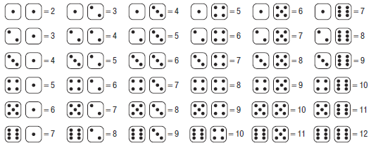
Example 5.1: Creating a Discrete Probability Distribution (cont.)

Slide 7


Example 5.1: Creating a Discrete Probability Distribution (cont.)
When rolling two dice, there are 36 possible rolls, each giving a sum between 2 and 12, inclusive. To find the probability distribution, we need to calculate the probability for each value.
because there is only one way to get a sum of 2:
because you may get the sum of 3 in two ways: or

Slide 8
Example 5.1: Creating a Discrete Probability Distribution (cont.)
Continuing this process will give us the following probability distribution.
Check for yourself that the probabilities listed are the true values for the probability distribution of X, the sum of two rolled dice.
Sum of Two Rolled Dice
x | 2 | 3 | 4 | 5 | 6 | 7 | 8 | 9 | 10 | 11 | 12
P(X = x)

Slide 9
Example 5.1: Creating a Discrete Probability Distribution (cont.)
Note that all of the probabilities are numbers between 0 and 1, inclusive, and that the sum of the probabilities is equal to 1. Check this for yourself. Therefore, the table qualifies as a probability distribution.

Slide 10
Expected Value
Expected Value
The expected value for a discrete random variable X is equal to the mean of the probability distribution of X and is given by
Where x_{i} is the i^{th} value of the random variable X.
In words:
The expected value of a random variable is computed as the sum of products of all possible values for the random variable, multiplied by their respective probabilities.

Slide 11
Example 5.2: Calculating Expected Values
Suppose that Randall and Blake decide to make a friendly wager on the football game they are watching one afternoon. For every kick the kicker makes, Blake has to pay Randall $30.00. For every kick the kicker misses, Randall has to pay Blake $40.00. Prior to this game, the kicker has made 18 of his past 23 kicks this season.

Slide 12
Example 5.2: Calculating Expected Values (cont.)
a. What is the expected value of Randall’s bet for one kick?
b. Suppose that the kicker attempts four kicks during the game. How much should Randall expect to win in total?

Slide 13
Example 5.2: Calculating Expected Values (cont.)
Solution
a. There are two possible outcomes for this bet: Randall wins $30.00 (x = 30.00) or Randall loses $40.00 (x = −40.00). If the kicker has made 18 of his past 23 kicks, then we assume that the probability that he will make a kick (and that Randall will win
the bet) is

Slide 14
Example 5.2: Calculating Expected Values (cont.)
By the Complement Rule, the probability that the kicker
will miss—and Randall will lose the bet—is
Randall’s Bet for One Kick
x | $30.00 | −$40.00
P(X = x)

Slide 15
Example 5.2: Calculating Expected Values (cont.)
Then we calculate the expected value as follows.

Slide 16
Example 5.2: Calculating Expected Values (cont.)
We see that the expected value of the wager is $14.78. Randall should expect that if the same bet were made many times, he would win an average of $14.78 per bet.

Slide 17
Example 5.2: Calculating Expected Values (cont.)
b. We know that over the long term Randall would win an average of $14.78 per bet. So for four attempted kicks, we multiply the expected value for one bet by four: If he and Blake place four bets, then Randall can expect to win approximately $59.12.

Slide 18
Example 5.3: Calculating Expected Values
Peyton is trying to decide between two different investment opportunities. The two plans are summarized in the table below. The left column for each plan gives the potential earnings, and the right columns give their respective probabilities. Which plan should he choose?

Slide 19
Example 5.3: Calculating Expected Values (cont.)
Investment Plans
Plan A |  | Plan B
Earnings | Probability | Earnings | Probability
$1200 | 0.1 | $1500 | 0.3
$950 | 0.2 | $800 | 0.1
$130 | 0.4 | −$100 | 0.2
−$575 | 0.1 | −$250 | 0.2
−$1400 | 0.2 | −$690 | 0.2

Slide 20
Example 5.3: Calculating Expected Values (cont.)
Solution
It is difficult to determine which plan will yield the higher return simply by looking at the probability distributions. Let’s use the expected values to compare the plans. Let the random variable be the earnings for Plan A, and let the random variable be the earnings for Plan B.

Slide 21
Example 5.3: Calculating Expected Values (cont.)
For Investment Plan A:

Slide 22
Example 5.3: Calculating Expected Values (cont.)
For Investment Plan B:

Slide 23
Example 5.3: Calculating Expected Values (cont.)
From these calculations, we see that the expected value of Plan A is $24.50, and the expected value of Plan B is $322.00. Therefore, Plan B appears to be the wiser investment option for Peyton.

Slide 24
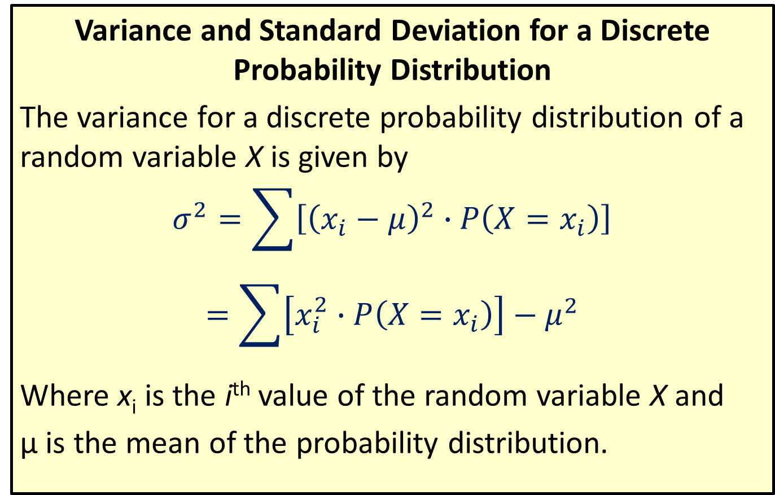
Variance and Standard Deviation for a Discrete Probability Distribution
Variance and Standard Deviation for a Discrete Probability Distribution
The variance for a discrete probability distribution of a random variable X is given by
$$σ^{2}=\sum{\left[{\left(x_{i}−μ\right)}^{2}∙P\left(X=x_{i}\right)\right]}$$
$$=\sum{\left[x_{i}^{2}∙P\left(X=x_{i}\right)\right]}−μ^{2}$$
Where x_{i} is the i^{th} value of the random variable X and
μ is the mean of the probability distribution.

Slide 25
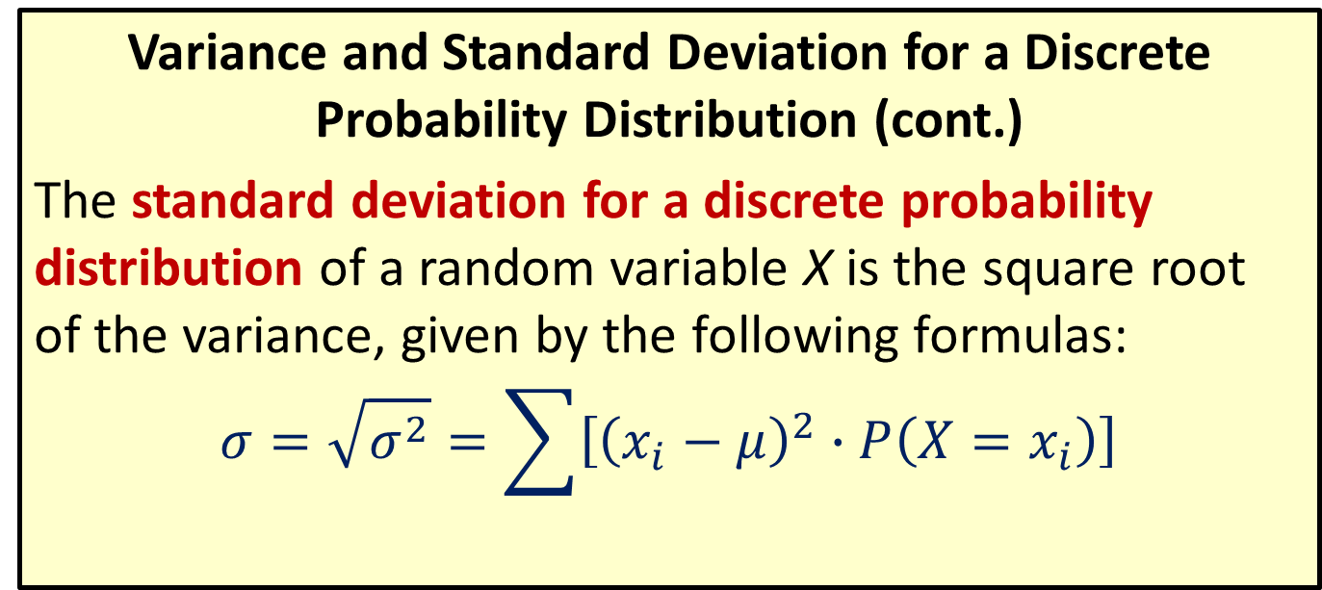
Formula
Variance and Standard Deviation for a Discrete Probability Distribution (cont.)
The standard deviation for a discrete probability distribution of a random variable X is the square root of the variance, given by the following formulas:
$$σ=\sqrt{σ^{2}}=\sum{\left[{\left(x_{i}−μ\right)}^{2}∙P\left(X=x_{i}\right)\right]}$$

Slide 26
Example 5.4: Calculating the Variances and Standard Deviations for Discrete Probability Distributions
Which of the investment plans in the previous example carries more risk, Plan A or Plan B?
Solution
To decide which plan carries more risk, we need to look at their standard deviations, which requires that we first calculate their variances. Let’s calculate the variance separately for each investment plan. To do this, we will use a table to organize our calculations as we compute the variance. We will use the expected values that we calculated in the previous example as the means.

Slide 27
Example 5.4: Calculating the Variances and Standard Deviations for Discrete Probability Distributions (cont.)
For Investment Plan A, μ = E(X_{A}) = $24.50
Investment Plan A
x | P(X = x)
$1200 | 0.1 | 1175.50 | 1,381,800.25 | 138,180.025
$950 | 0.2 | 925.50 | 856,550.25 | 171,310.05
$130 | 0.4 | 105.60 | 11,130.25 | 4452.1
−$575 | 0.1 | −599.50 | 359,400.25 | 35,940.025
−$1400 | 0.2 | −1424.50 | 2,029,200.25 | 405,840.05

Slide 28
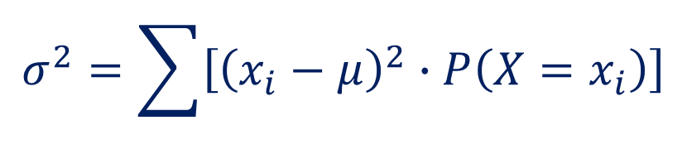
Example 5.4: Calculating the Variances and Standard Deviations for Discrete Probability Distributions (cont.)
$$σ^{2}=\sum{\left[{\left(x_{i}−μ\right)}^{2}∙P\left(X=x_{i}\right)\right]}$$

Slide 29
Example 5.4: Calculating the Variances and Standard Deviations for Discrete Probability Distributions (cont.)
For Investment Plan B,
Investment Plan B
x | P(X = x)
$1500 | 0.3 | 1178 | 1,387,684 | 416,305.2
$800 | 0.1 | 478 | 228,484 | 22,848.4
−$100 | 0.2 | 422 | 178,084 | 35,616.8
−$250 | 0.2 | 572 | 327,184 | 65,436.8
−$690 | 0.2 | 1012 | 1,024,144 | 204,828.8

Slide 30
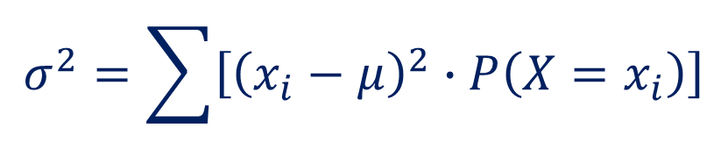
Example 5.4: Calculating the Variances and Standard Deviations for Discrete Probability Distributions (cont.)
$$σ^{2}=\sum{\left[{\left(x_{i}−μ\right)}^{2}∙P\left(X=x_{i}\right)\right]}$$

Slide 31
Example 5.4: Calculating the Variances and Standard Deviations for Discrete Probability Distributions (cont.)
What do these results tell us? Comparing the standard deviations, we see that not only does Plan B have a higher expected value, but its profits vary slightly less than those of Plan A. We may conclude that Plan B carries a slightly lower amount of risk than Plan A.

Slide 32
HLS UNTDBS Lesson 6.1

Slide 33

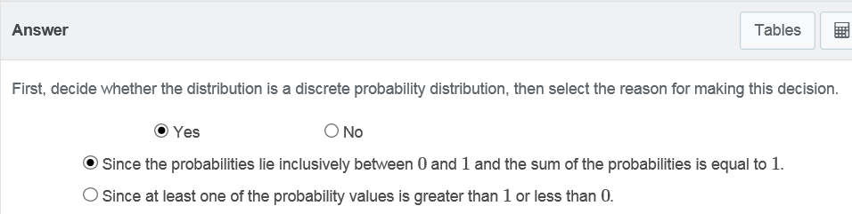
HLS UNTDBS Lesson 6.1: Example questions
Determine whether or not the distribution is a discrete probability distribution and select the reason why or why not.

Slide 34
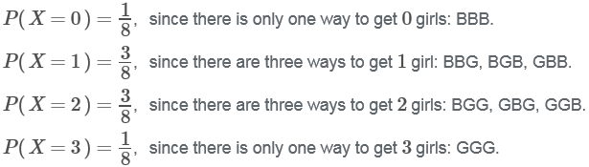
HLS UNTDBS Lesson 6.1: Example questions
Construct the discrete probability distribution for the random variable described. Express the probabilities as simplified fractions.
The number of girls out of 3 newborns.
Solution: The total number of possible outcomes in the sample space is 2³ = 8. The possible outcomes are 0 girls, 1 girl, 2 girls, or 3 girls. We need to calculate the probability for each event.

Slide 35
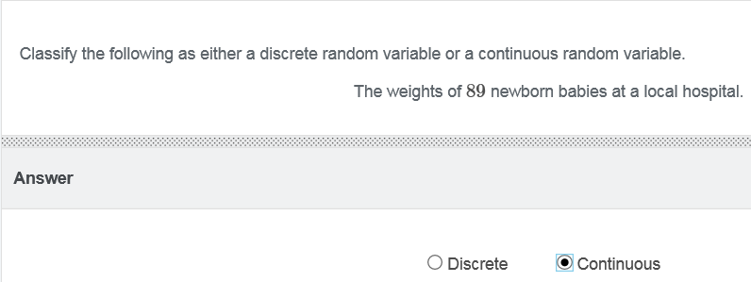
HLS UNTDBS Lesson 6.1: Example questions

Slide 36
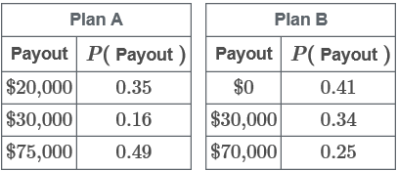

HLS UNTDBS Lesson 6.1: Example questions Use HLS6.1_DiscreteProbability_worksheet file
In the long run, which plan has the higher payout?
STEP 1
Copy the data and paste in Excel, in a blank spreadsheet, in cell A1
Solution: Your strategy is to transfer the data into Excel (using the Copy Data button), where you will compute the expected value for each plan, using the sum of products of all possible payouts (i.e., outcomes), each multiplied by the corresponding probability. The next screen shows you how to do that.

Slide 37
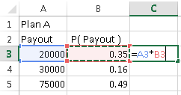
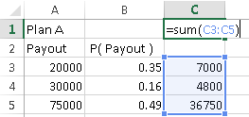
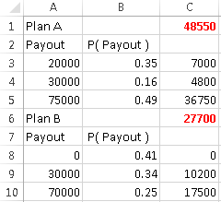

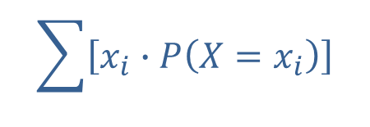
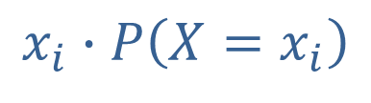
HLS UNTDBS Lesson 6.1: Example questions
$$x_{i}∙P\left(X=x_{i}\right)$$
STEP 3
$$\sum{\left[x_{i}∙P\left(X=x_{i}\right)\right]}$$
STEP 2
STEP 4
STEP 5
Submit the answer
Compare the two expected values

Slide 38

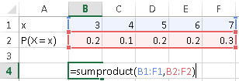
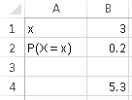

HLS UNTDBS Lesson 6.1: Example questions
Find the expected value E( X ) of the following data. Round your answer to one decimal place.
STEP 1
STEP 2
Compute the expected value using the SUMPRODUCT function
Report the answer
STEP 3

Slide 39
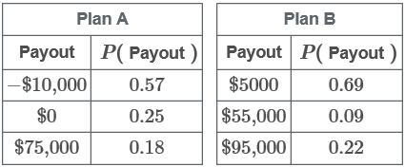
HLS UNTDBS Lesson 6.1: Example questions
Which plan has the least amount of risk?
STEP 1
Copy the data and paste in Excel, in a blank spreadsheet, in cell A1
Solution: You need to calculate the variance for each plan. A lower variance means lower volatility, which means lower risk. Your strategy is to first compute the mean, and then compute the variance as the sum of all possible payout deviations from the mean squared, each multiplied by the corresponding probability. The next screens show you how to do all that.

Slide 40
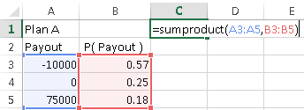
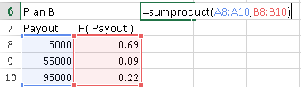
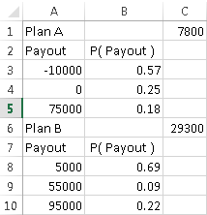
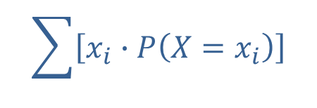
HLS UNTDBS Lesson 6.1: Example questions
Compute each expected value using the SUMPRODUCT function in cells C1 and C6
$$\sum{\left[x_{i}∙P\left(X=x_{i}\right)\right]}$$
STEP 2

Slide 41
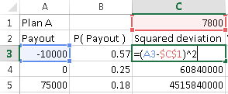
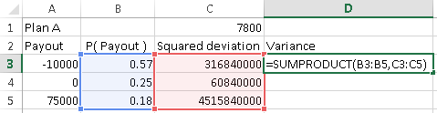
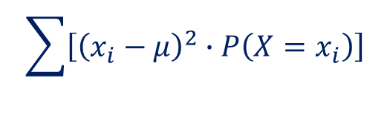

HLS UNTDBS Lesson 6.1: Example questions
$${\left(x_{i}−μ\right)}^{2}$$
STEP 3
For each payout, compute its squared deviation from the mean. The $ in formula $C$1 will allow to copy/paste from C3 down to cells C4 and C5 without moving the reference to cell C1 (=the mean)
$$\sum{\left[{\left(x_{i}−μ\right)}^{2}∙P\left(X=x_{i}\right)\right]}$$
STEP 4
Compute each variance as the sum of products of the squared deviations in column C multiplied by the probabilities in column B

Slide 42
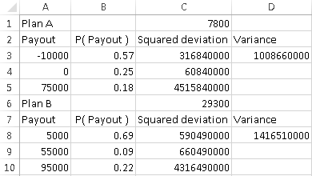
HLS UNTDBS Lesson 6.1: Example questions
STEP 5
Compare the two variances and report the lowest variance as the lowest risk
Final answer:

Slide 43

HLS UNTDBS Lesson 6.1: Example questions
Find the standard deviation of the following data. Round your answer to one decimal place.
STEP 1
STEP 2
Compute the expected value using the SUMPRODUCT function
Report the answer
STEP 3

